Slide 1

Raspberry PI and AI Stream
ZAS
Academy
Dr. Roohi Banu
Mr. Fakruddin Mohammed

Slide 2
Day 1.
Raspberry PI - AI, ML, DL & RL Introduction
ZAS
Academy
Dr. Roohi Banu
Mr. Fakruddin Mohammed

Slide 3
Agenda
Course Objectives
What is Data Analytics?
What is Data Science?
Data Science Life Cycle
What is AI?
Syllabus Review
https://blogs.nvidia.com/blog/2016/07/29/whats-difference-artificial-intelligence-machine-learning-deep-learning-ai/

Slide 4
Course Objectives
To provide you the insights into hot topics like AI/ML/DL/Data Science/Data Analytics
To give you deeper knowledge on the above topics so you can tackle real-life, meaningful topic for your IB Extended Essay
To prepare you for university admission interviews.
https://blogs.nvidia.com/blog/2016/07/29/whats-difference-artificial-intelligence-machine-learning-deep-learning-ai/

Slide 5
AI Introduction: What is Data Analytics?
Analytics is the discipline that applies logic and mathematics
to data to provide insights for making better decisions
It includes methods such as Data Mining, Statistics and Machine Learning
Data Mining is the practice of searching large amounts of data to find patterns or trends
https://blogs.nvidia.com/blog/2016/07/29/whats-difference-artificial-intelligence-machine-learning-deep-learning-ai/

Slide 6
AI Introduction: What is Data Analytics?
It includes methods such as Data Mining, Statistics and Machine Learning
Data Mining is the practice of searching large amounts of data to find patterns or trends
https://blogs.nvidia.com/blog/2016/07/29/whats-difference-artificial-intelligence-machine-learning-deep-learning-ai/

Slide 7
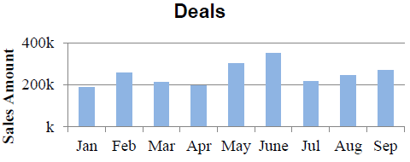
AI Introduction: Types of Data Analytics
Descriptive Analytics What happened? | Diagnostic Analytics Why did it happened? What happened in June and Jan?
Predictive Analytics Predicts future outcome using historical data and external knowledge What will be the sales in Oct? | Prescriptive Analytics It anticipates: What will happen When will it happen Why it will happen How to make it happen
https://blogs.nvidia.com/blog/2016/07/29/whats-difference-artificial-intelligence-machine-learning-deep-learning-ai/

Slide 8
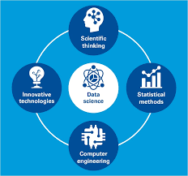
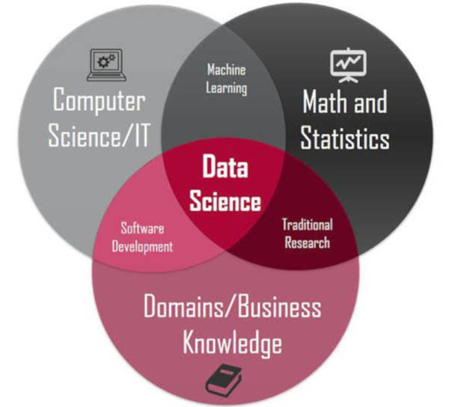
AI Introduction: What is Data Science?
Data science is an inter-disciplinary field that uses scientific methods, processes, algorithms and systems to extract knowledge and insights from many structural and unstructured data.
Data science is related to data mining, machine learning and big data
https://blogs.nvidia.com/blog/2016/07/29/whats-difference-artificial-intelligence-machine-learning-deep-learning-ai/

Slide 9
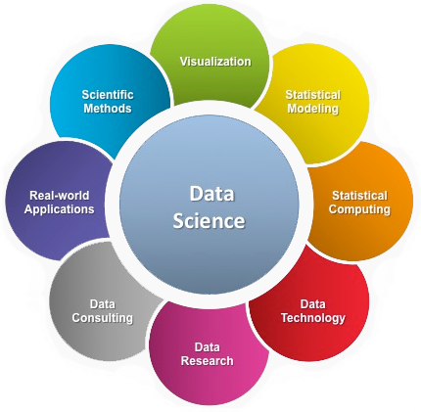
AI Introduction: What is Data Science?
https://blogs.nvidia.com/blog/2016/07/29/whats-difference-artificial-intelligence-machine-learning-deep-learning-ai/

Slide 10
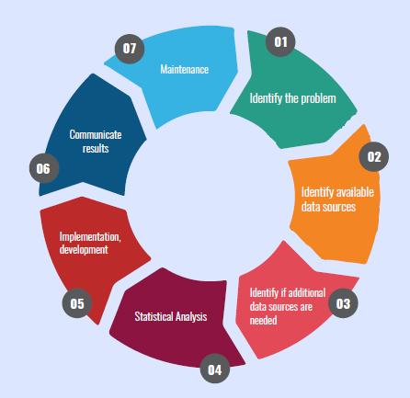
AI Introduction: Data Science Life Cycle
https://blogs.nvidia.com/blog/2016/07/29/whats-difference-artificial-intelligence-machine-learning-deep-learning-ai/

Slide 11
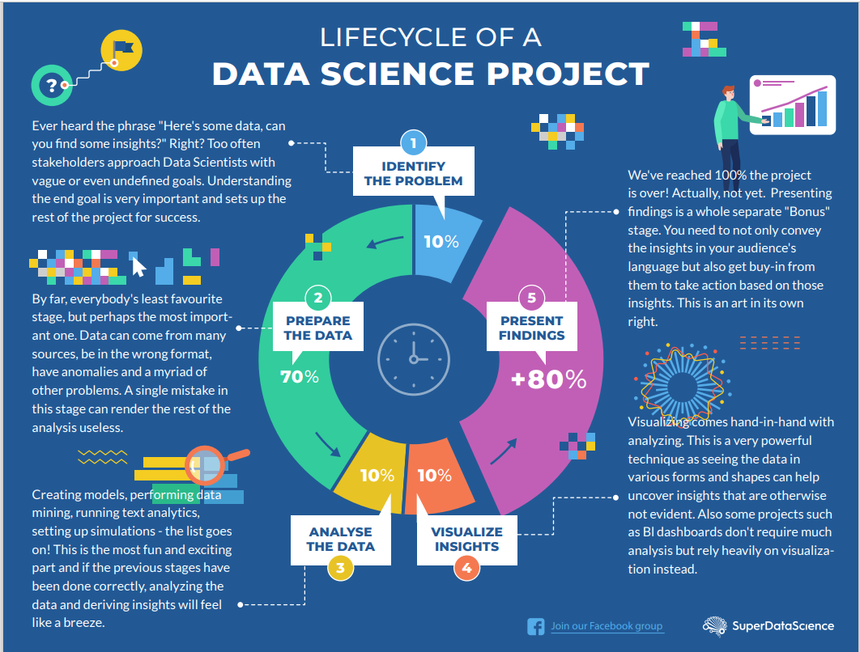
AI Introduction: Data Science Life Cycle
https://blogs.nvidia.com/blog/2016/07/29/whats-difference-artificial-intelligence-machine-learning-deep-learning-ai/

Slide 12
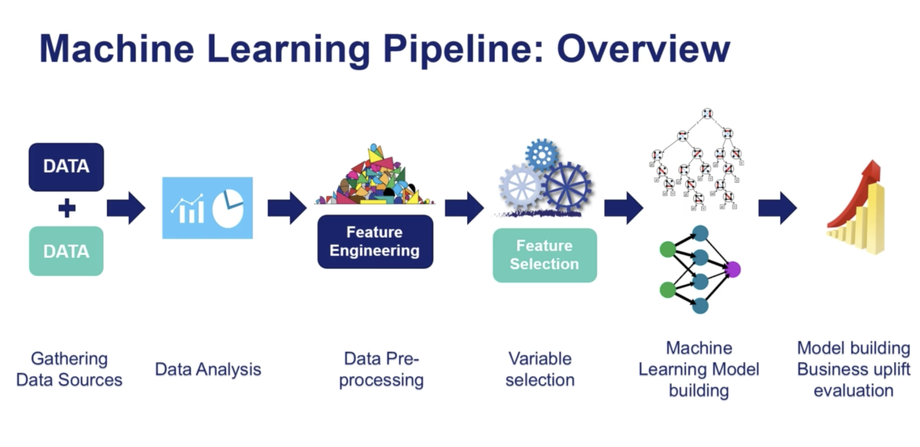
AI Introduction: Data Science Life Cycle
https://blogs.nvidia.com/blog/2016/07/29/whats-difference-artificial-intelligence-machine-learning-deep-learning-ai/

Slide 13
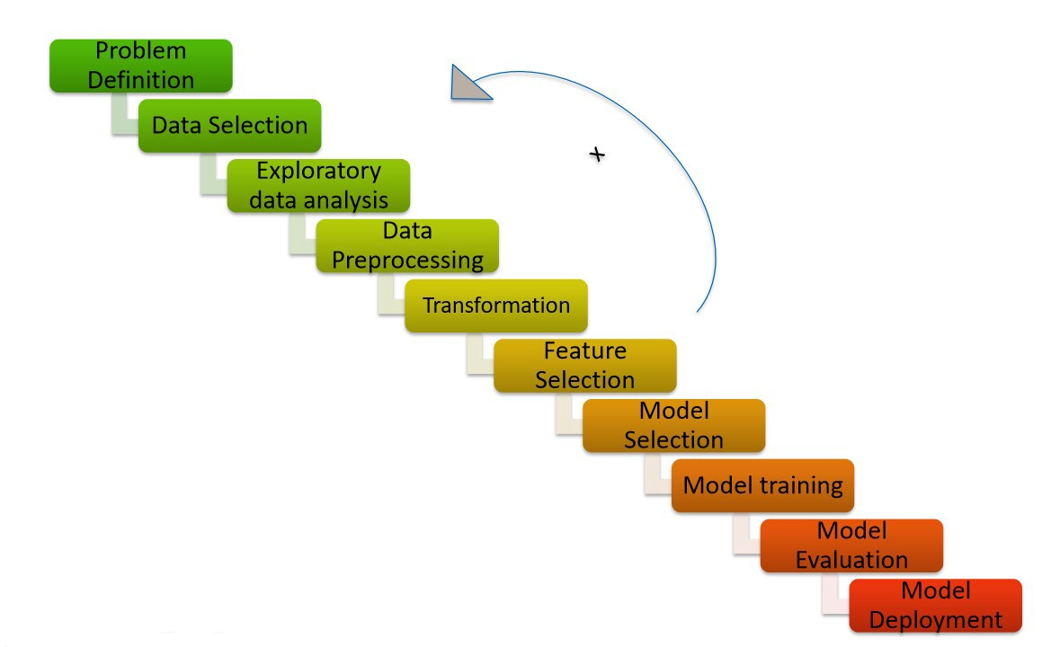
AI Introduction: Data Science Life Cycle
https://blogs.nvidia.com/blog/2016/07/29/whats-difference-artificial-intelligence-machine-learning-deep-learning-ai/

Slide 14
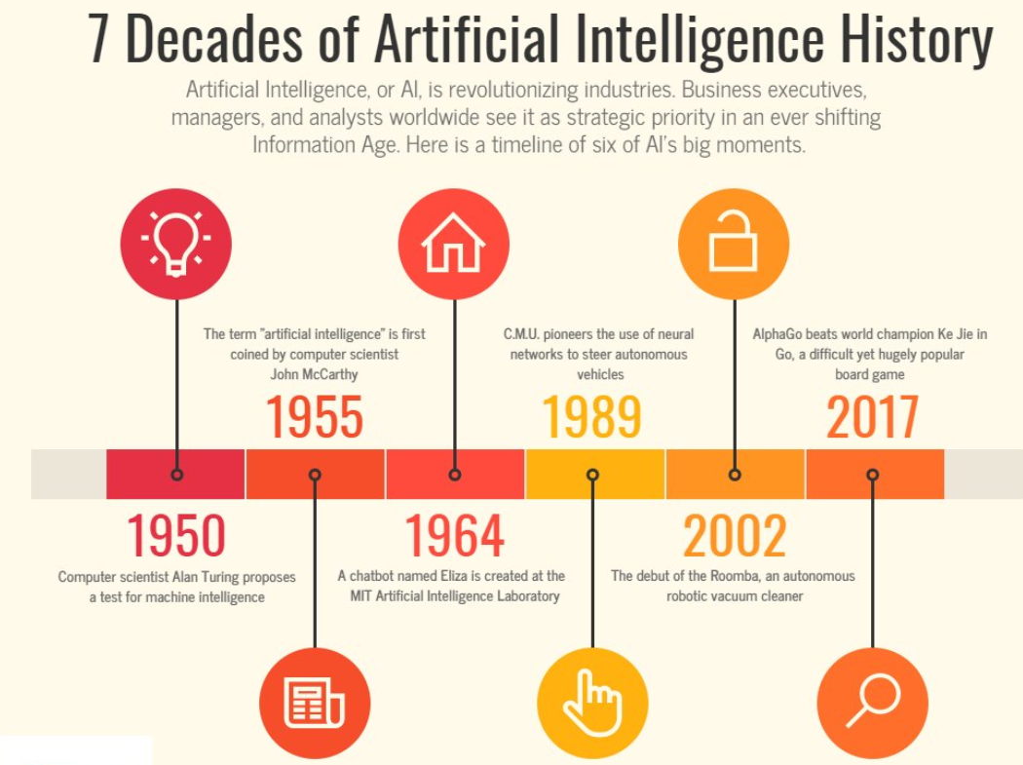
AI History
https://twitter.com/2morrowknight/status/941128818605015040/photo/1

Slide 15
AI History
AI is concerned with the design of “Intelligence” in “Artificial Device”
Intelligence: Behaves/thinks/analyses/reasons like human
Artificial Device: Software/Hardware/Machine
Recognizing people, objects. –
Communicating (through natural language). –
Navigating around obstacles on the streets
Medical Diagnosis
Playing games like Go/Chess etc.
https://twitter.com/2morrowknight/status/941128818605015040/photo/1

Slide 16
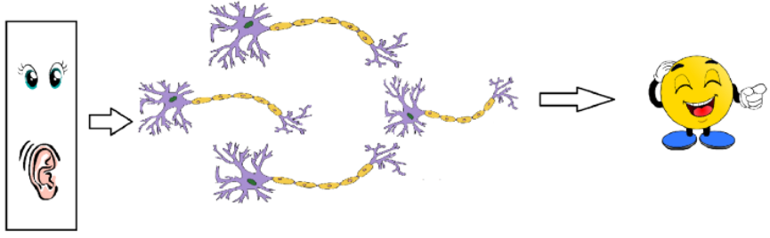
AI Introduction: Biological Neuron
https://medium.com/@jayeshbahire/the-xor-problem-in-neural-networks-50006411840b#:~:text=The%20XOr%2C%20or%20%E2%80%9Cexclusive%20or,value%20if%20they%20are%20equal.

Slide 17
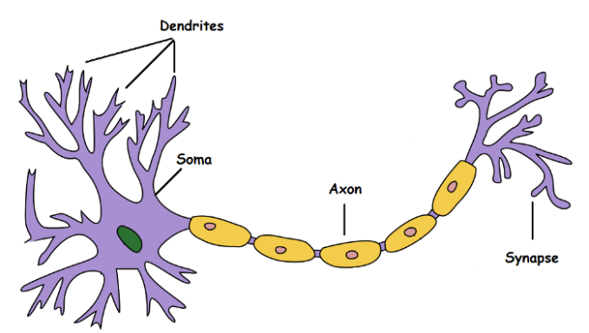
AI Introduction: Biological Neuron
Neuron Inputs
Processing
Other Neurons
Output
https://medium.com/@jayeshbahire/the-xor-problem-in-neural-networks-50006411840b#:~:text=The%20XOr%2C%20or%20%E2%80%9Cexclusive%20or,value%20if%20they%20are%20equal.

Slide 18
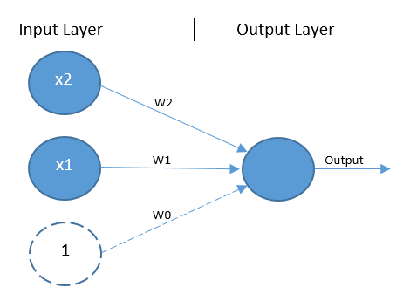
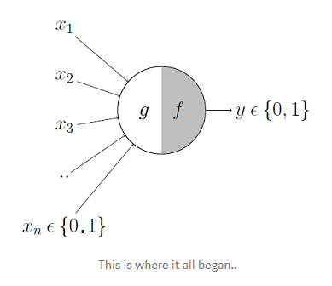

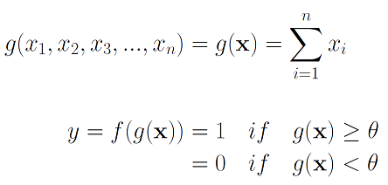
AI Introduction: Simple Perceptron/Neuron
https://towardsdatascience.com/mcculloch-pitts-model-5fdf65ac5dd1

Slide 19
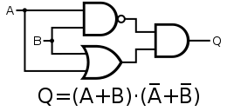
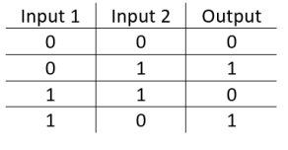
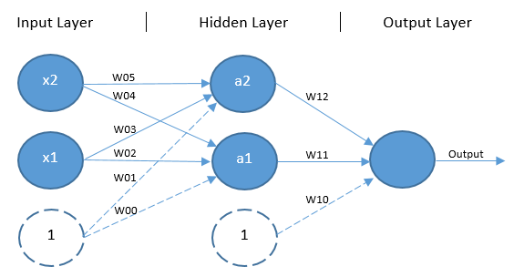
AI Introduction: Feed Forward Neural Network
https://medium.com/@jayeshbahire/the-xor-problem-in-neural-networks-50006411840b#:~:text=The%20XOr%2C%20or%20%E2%80%9Cexclusive%20or,value%20if%20they%20are%20equal.

Slide 20
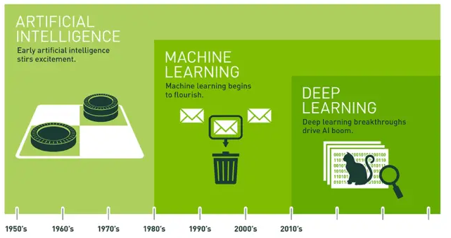
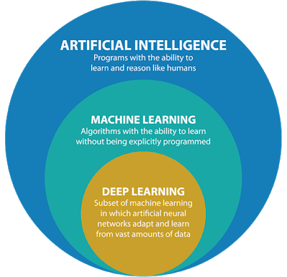
AI Introduction: ML/DL/RL
https://blogs.nvidia.com/blog/2016/07/29/whats-difference-artificial-intelligence-machine-learning-deep-learning-ai/

Slide 21
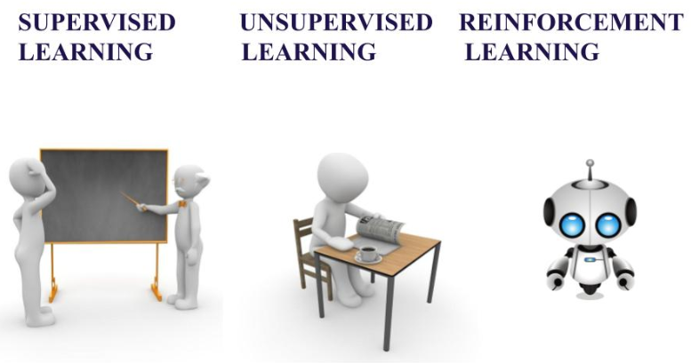
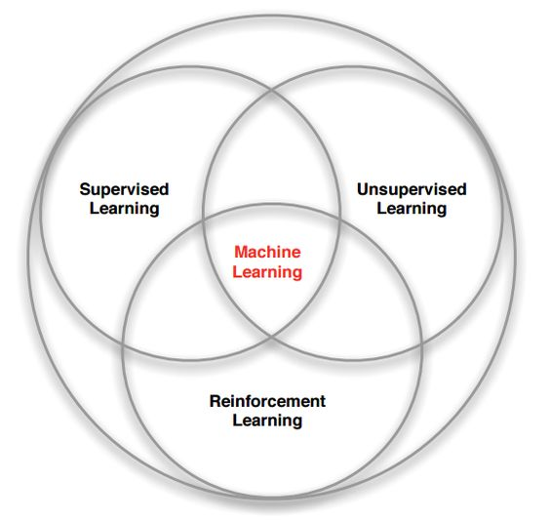
AI Introduction: Machine Learning
Given
Inputs
Outputs
Given
Start State
End State
Given
Inputs
https://blogs.nvidia.com/blog/2016/07/29/whats-difference-artificial-intelligence-machine-learning-deep-learning-ai/

Slide 22
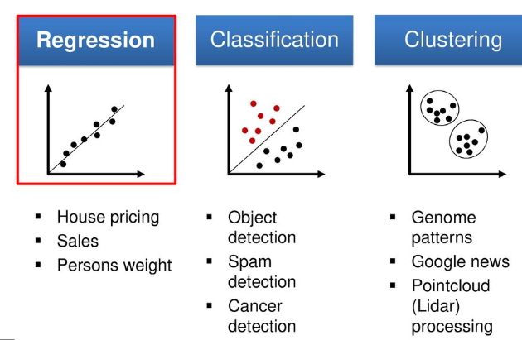
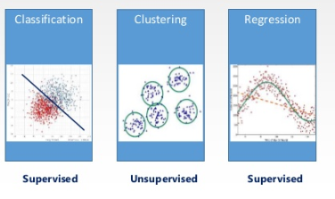
AI Introduction: Machine Learning
Regression → SL in Continuous Domain
Classification: SL in Non-Continuous Domain
Clustering: USL to Find Patterns in Data
https://blogs.nvidia.com/blog/2016/07/29/whats-difference-artificial-intelligence-machine-learning-deep-learning-ai/

Slide 23

AI Introduction: Machine Learning
https://blogs.nvidia.com/blog/2016/07/29/whats-difference-artificial-intelligence-machine-learning-deep-learning-ai/

Slide 24
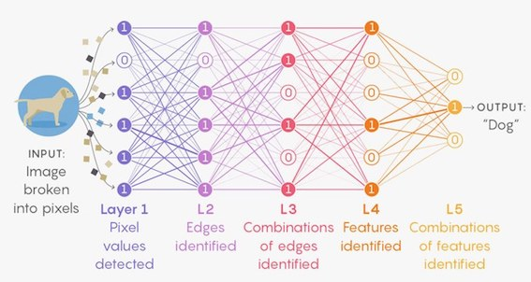
AI Introduction: Deep Learning
➔
1 Hidden Layer
N Hidden Layers
https://blogs.nvidia.com/blog/2016/07/29/whats-difference-artificial-intelligence-machine-learning-deep-learning-ai/

Slide 25
AI Introduction: Deep Learning
https://blogs.nvidia.com/blog/2016/07/29/whats-difference-artificial-intelligence-machine-learning-deep-learning-ai/

Slide 26
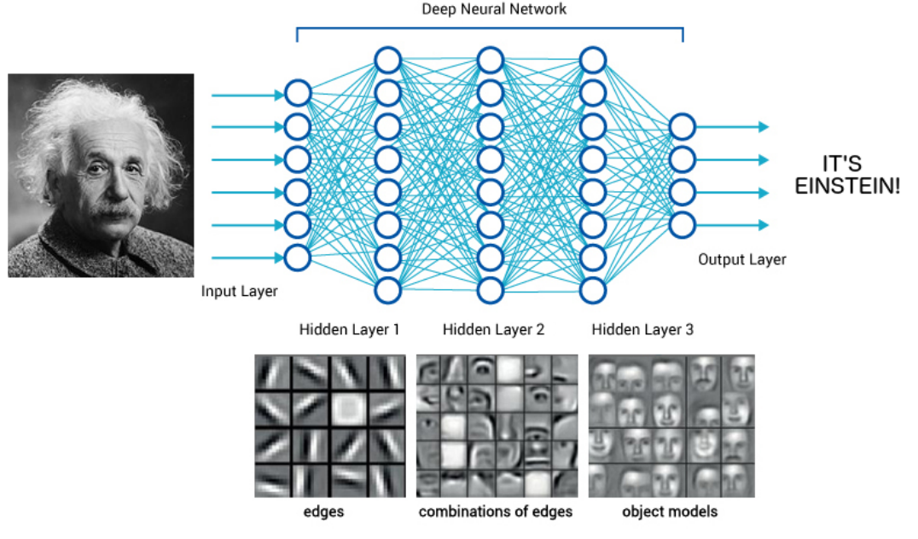
AI Introduction: Deep Learning
https://blogs.nvidia.com/blog/2016/07/29/whats-difference-artificial-intelligence-machine-learning-deep-learning-ai/

Slide 27
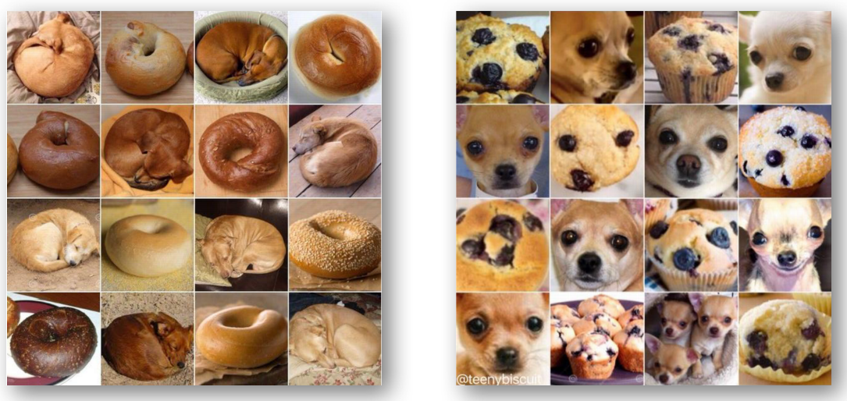
AI Introduction: Deep Learning
https://blogs.nvidia.com/blog/2016/07/29/whats-difference-artificial-intelligence-machine-learning-deep-learning-ai/

Slide 28

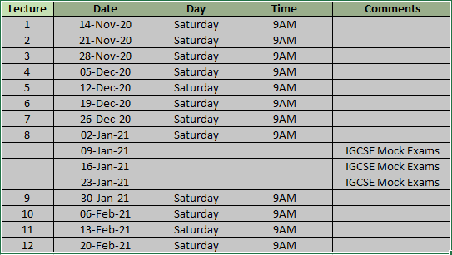

Z A S A C A D E M Y
Raspberry PI - Machine and Deep Learning
(12 Weeks ADVANCED Course for Secondary & College Students)
@78 99 11 222 5
Week1
Week2
Week3
Week4
Week5
Week6
AI Introduction & ML/DL Life Cycle
Data Handling (Pandas & Numpy)
Data Handling & Visualization (matplotlib)
Probability & Statistics (Variable Selection)
Regression
Classification
Course content may be altered depending on participant needs & speed of grasping power
Week7
Week8
Week9
Week10
Week11
Week12
Artificial Neural Networks & Backpropagation
2 Layers Neural Networks & CNN Intuition
Deep Learning CNN & Raspberry PI
Deep Learning CNN & Raspberry PI
Deep Learning CNN & Raspberry PI
Deep Learning CNN & Raspberry PI
Live ZOOM Lectures from 14-Nov:
Natural Language Processing – NLP - ???
At the end of course participants will have
Thorough & deeper understanding of AI/ML/DL (Neural Networks)
Seen full end-to-end life cycle of Data Science Projects
Built at least 1 Deep Learning OBJECT DETECTION model from SCRATCH end-to-end and deploy on to PI

